Slide 1
Using Salesforce’s Business Hours object to determine SLAs February 24, 2016
Mike Merino
Mercury Payment Systems
Mike.merino@vantiv.com

Slide 2
Business Hours: This Salesforce object is used to specify the business hours of your support organization. Escalation rules are run only during these hours. If business hours are associated with any Holiday records, then business hours and escalation rules associated with business hours are suspended during the dates and times specified as holidays. (e.g. business hours are 8-5 and a call comes in at 4:45 pm, if salesman makes call by 8:15 am the next morning, this is a business hours difference of 30 minutes) SLA: Service Level Agreement, in this case the time by which an action needs to be completed Business Requirements: As Merchant Sales, I need a way to determine if leads are called within a SLA.
Definitions:

Slide 3
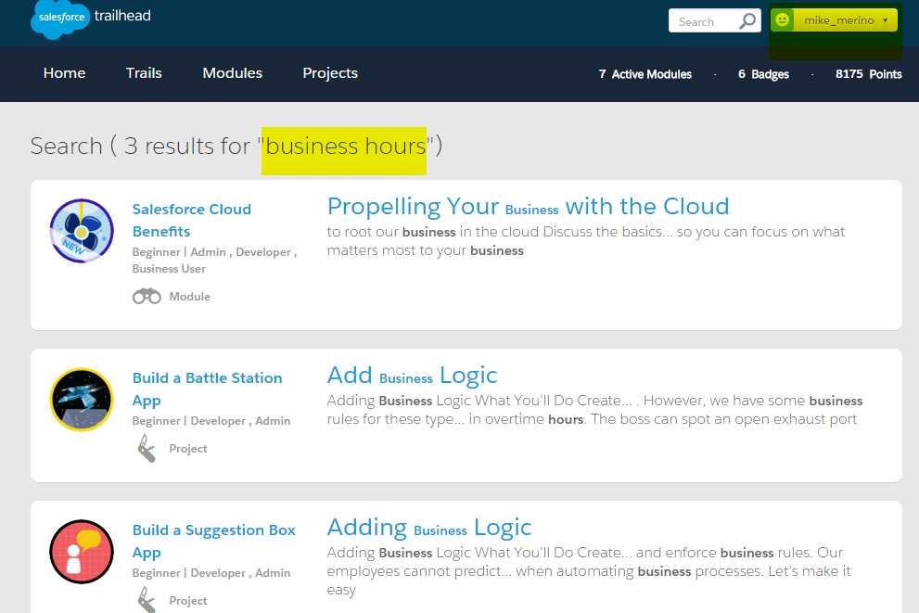
Trailhead

Slide 4
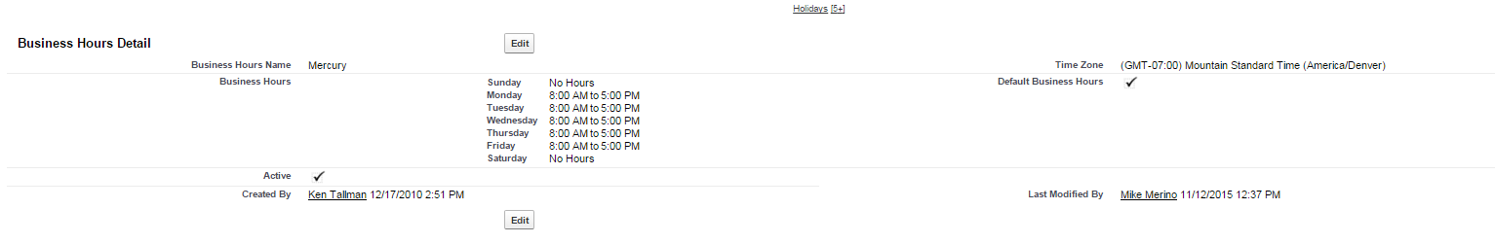
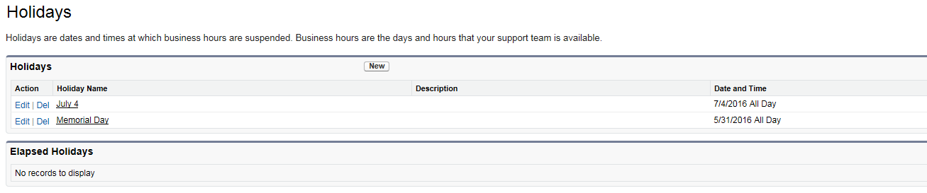
Setup > Administer > Company Profile > Business Hours Setup > Administer > Company Profile > Holidays
Salesforce Objects:

Slide 5
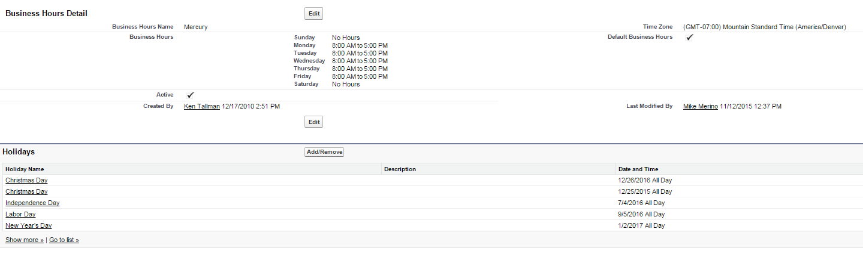
Setup > Administer > Company Profile > Business Hours
Salesforce Objects:

Slide 6
Salesforce Methods: the old way
https://blog.internetcreations.com/2012/08/salesforce-business-days/#.VsICo_krKzc

Slide 7
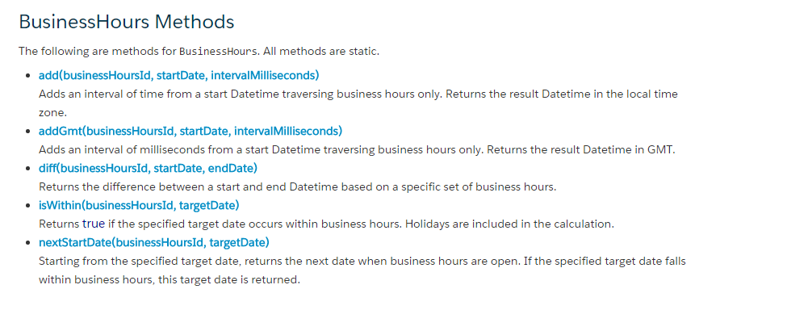
Salesforce Methods: Winter ‘14 release

Slide 8
Given the 1st two examples inhttp://www.salesforce.com/us/developer/docs/apexcode/Content/apex_classes_businesshours.htm The following holds for my user in the CEST time zone: System.assertEquals('2008-05-28 00:06:08', '' + nextTime); System.assertEquals('2008-05-28 00:06:08', '' + nextTimeGmt); System.assertEquals('28-05-2008 02:06:08 CEST', nextTime.formatLong()); System.assertEquals('28-05-2008 02:06:08 CEST', nextTimeGmt.formatLong()); That is, no observable difference between "add" and "addGmt".
This was selected as the best answer
Salesforce Methods: Difference between add & addGMT

Slide 9
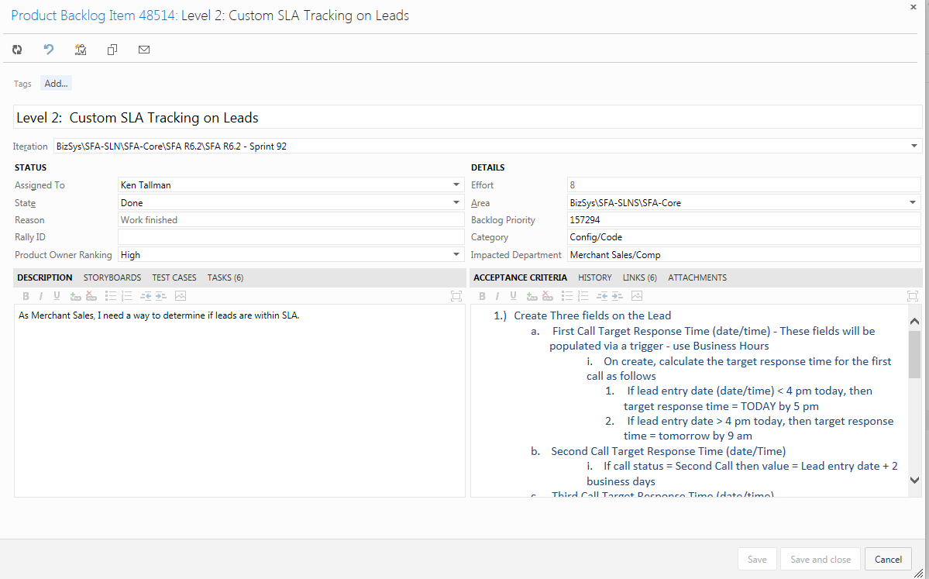
Visual Studio Team Foundation Server 2013:

Slide 10
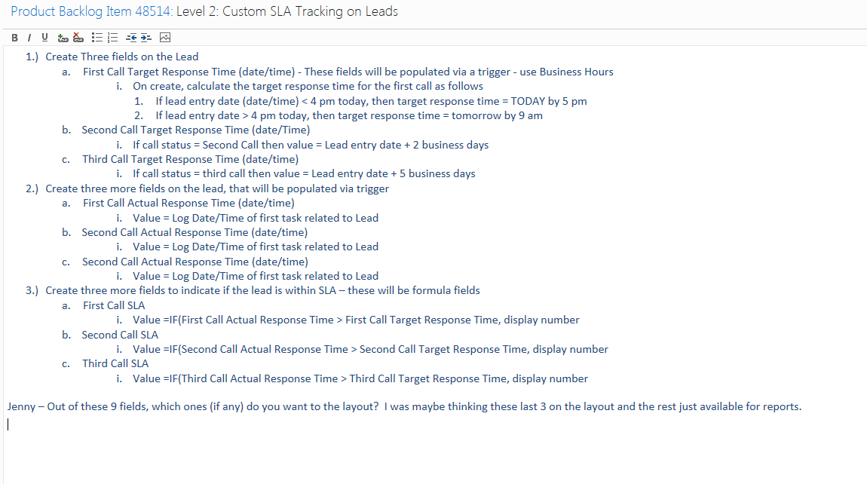
1.) Create Three fields on the Lead a. First Call Target Response Time (date/time) - These fields will be populated via a trigger - use Business Hours i. On create, calculate the target response time for the first call as follows 1. If lead entry date (date/time) < 4 pm today, then target response time = TODAY by 5 pm 2. If lead entry date > 4 pm today, then target response time = tomorrow by 9 am b. Second Call Target Response Time (date/Time) i. If call status = Second Call then value = Lead entry date + 2 business days c. Third Call Target Response Time (date/time) i. If call status = third call then value = Lead entry date + 5 business days
Salesforce Business Requirements:

Slide 11
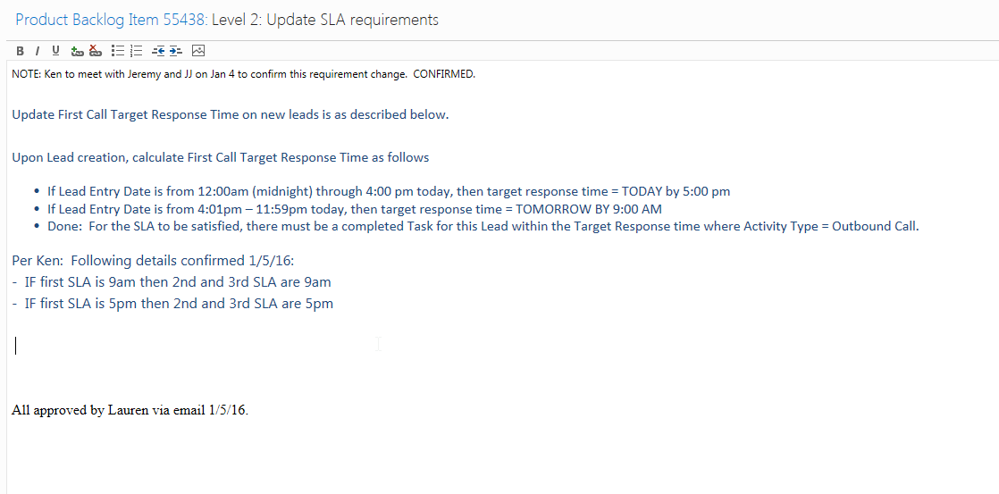
Procedure: Update 2 triggers, LeadBefore and TaskAfter
Salesforce Business Requirements:

Slide 12
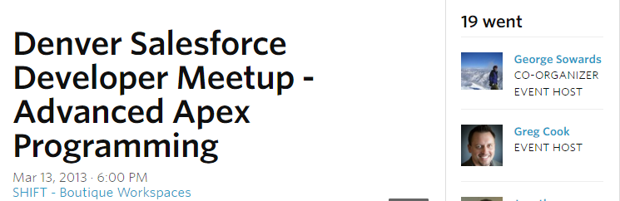
see Advanced Apex Programming by Dan Appleman using Custom Settings AND
Salesforce Business Requirements:

Slide 13
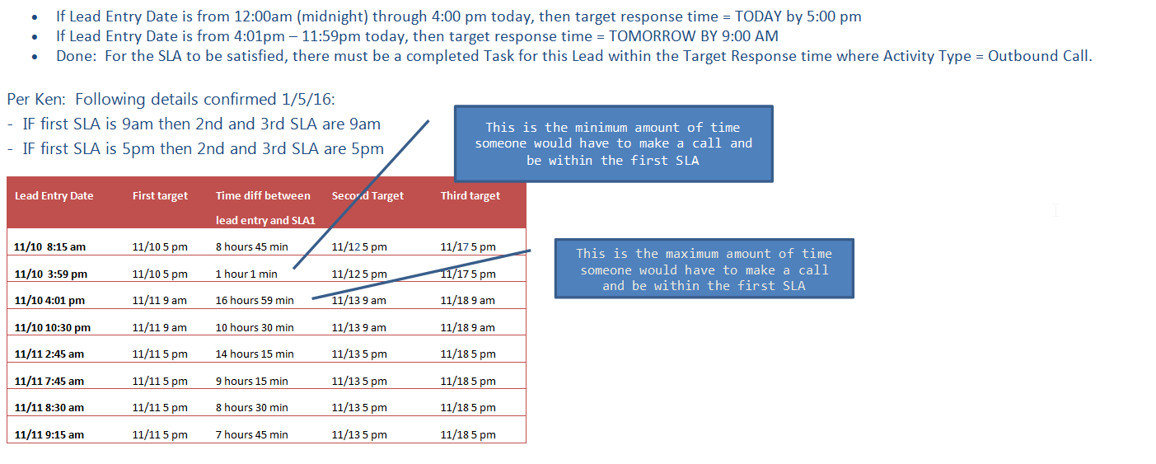
Setup Business Hours and Holidays 13 custom fields (Lead: 10, Task: 3) 1 custom label 1 custom setting 3 page layouts 2 triggers (Lead, Task) 1 test class
Salesforce Business Requirements:

Slide 14
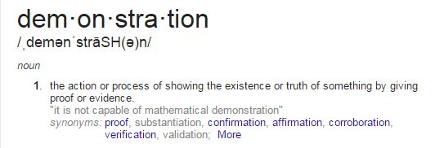
Notes:
taskAfter lines 57
leadAFter line 28
// in case lead entry date on sat/sun or holiday
Boolean iswithin = BusinessHours.isWithin(bh.id, l.lead_entry_date__c);
dt= iswithin ? l.lead_entry_date__c : BusinessHours.nextStartDate(bh.id, l.lead_entry_date__c);
No??
Change timezone of user to pacific

Slide 15
1. How to get 2 decimal points on hours between? 2. What happens if a lead is entered on a Saturday? 3. President’s Day Holiday? 3. Is LeadAfter line 29 necessary? 4. What happens if a user is in a different timezone?
Salesforce Enhancements
Notes:
taskAfter lines 57
leadAFter line 28
// in case lead entry date on sat/sun or holiday
Boolean iswithin = BusinessHours.isWithin(bh.id, l.lead_entry_date__c);
dt= iswithin ? l.lead_entry_date__c : BusinessHours.nextStartDate(bh.id, l.lead_entry_date__c);
No??
Change timezone of user to pacific

Slide 16

Notes:
taskAfter lines 57
leadAFter line 28
// in case lead entry date on sat/sun or holiday
Boolean iswithin = BusinessHours.isWithin(bh.id, l.lead_entry_date__c);
dt= iswithin ? l.lead_entry_date__c : BusinessHours.nextStartDate(bh.id, l.lead_entry_date__c);
change timezone of user to pacific

